Slide 1

BIG DATA Introduction

Slide 2

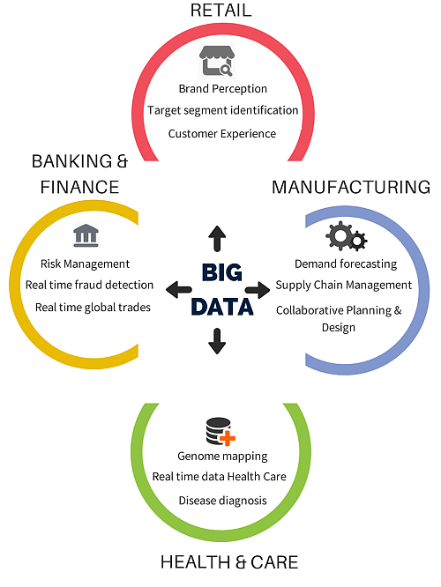
Industries using Big data

Slide 3
Challenges of traditional decision-making
Takes long time to arrive at a decision.
Planning, execution and reporting is not linked
Provides only birds eye view
Unable to make fully informed decisions

Slide 4
Big Data Analytics as a solution
Decision making based on analytics
Capable of handling all type of data
Faster decision making
Detailed view
Comprehensive solution gathering all the aspects

Slide 5
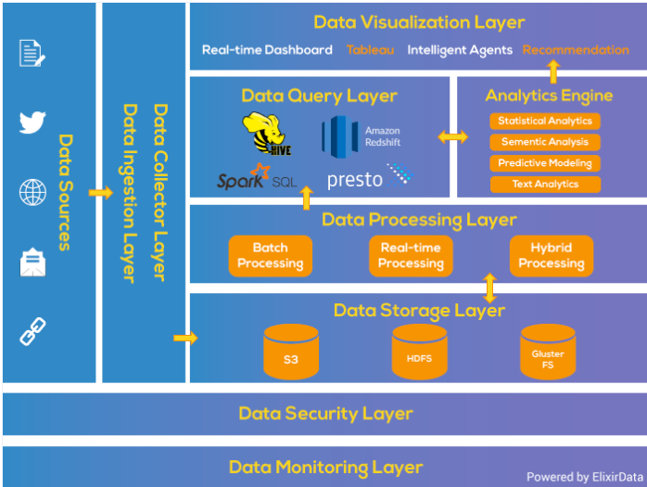


Big data Analytical Pipeline
https://www.xenonstack.com/blog/big-data-architecture/

Slide 6
What is Big data
Big Data is a collection of data that is huge in volume, yet growing exponentially with time. It is a data with so large size and complexity that none of traditional data management tools can store it or process it efficiently. Big data is also a data but with huge size.

Slide 7
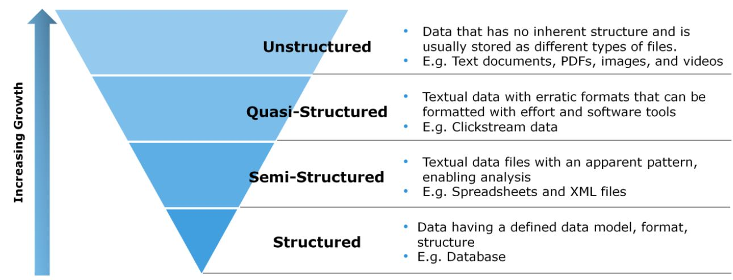
Types of Data

Slide 8
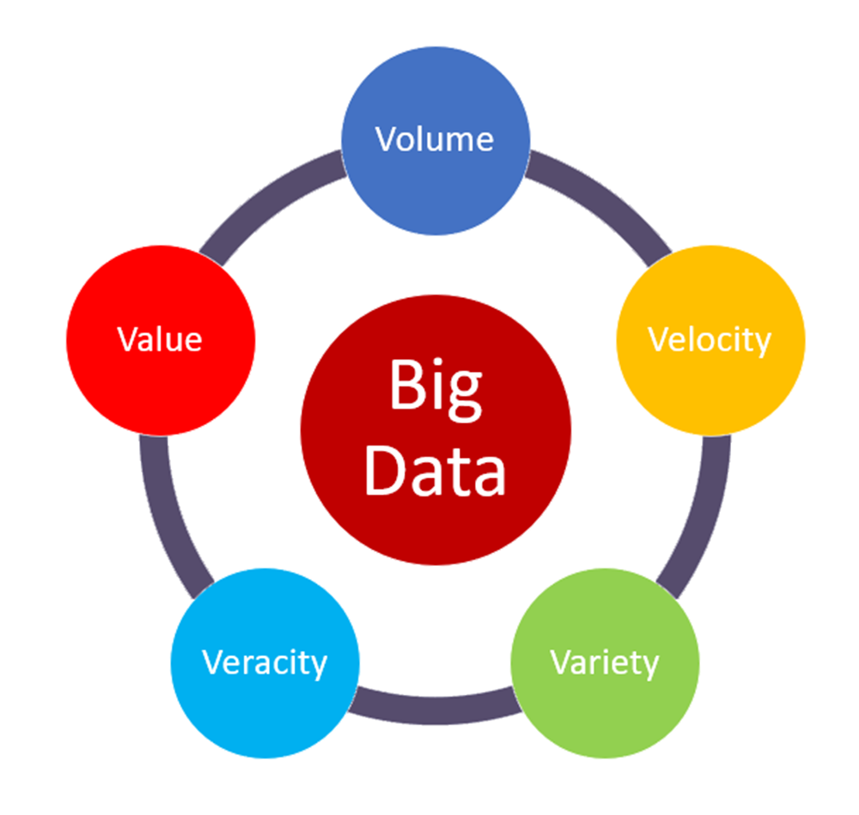
5 V’s of Big Data

Slide 9
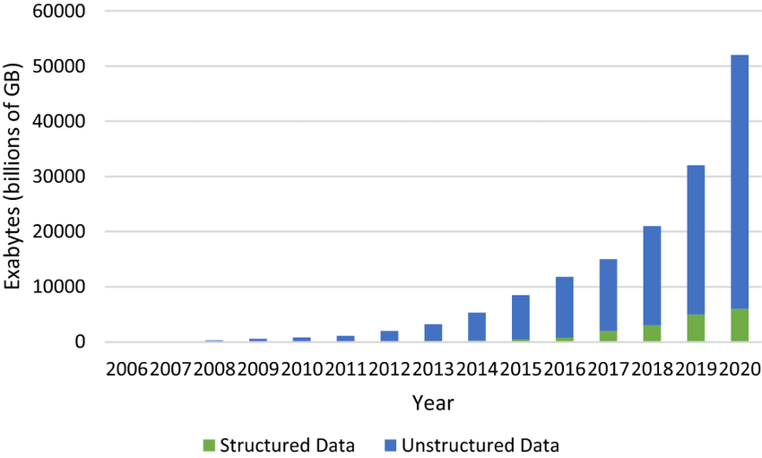
Growth of structured data vs unstructured data

Slide 10
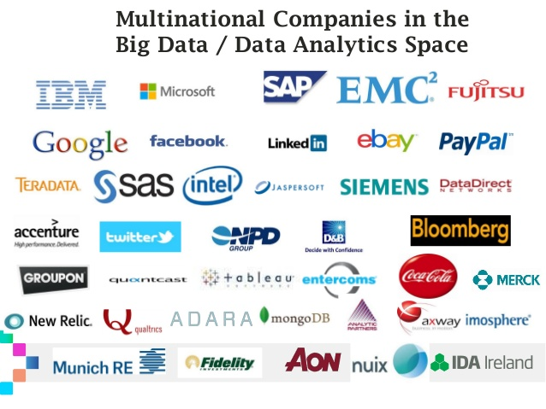

Slide 11
Distributed system challenges
Failure Handling: Failure handling can be difficult with distributed systems because some components fail while others continue to function. This can often serve as an advantage to prevent large-scale failures, but it also lead to more complexity when it comes to troubleshooting and debugging.
Concurrency: A common issue occurs when several clients attempt to access a shared resource simultaneously. You must ensure that all resources are safe in a concurrent environment.
Security issues: Data security and sharing have increased risks in distributed computer systems. The network has to be secured, and users must be able to safely access replicated data across multiple locations.
Higher initial infrastructure costs: The initial deployment cost of a distributed system can be higher than a single system. This pricing includes basic network setup issues, such as transmission, high load, and loss of information.

